Slide 1
Accounting Information Systems
Lecture 4
Transaction Cycles: The Revenue Cycle
Notes:
3

Slide 2
Objectives for Lecture 4
The Revenue Cycle
Tasks performed in the revenue cycle, regardless of the technology used
Functional departments in the revenue cycle and the flow of revenue transactions through the organization
Documents, journals, and accounts needed for audit trails, the maintenance of records, decision making, and financial reporting
Risks associated with the revenue cycle and the controls that reduce these risks
The operational and control implications of technology used to automate and reengineer the revenue cycle
Notes:
3

Slide 3
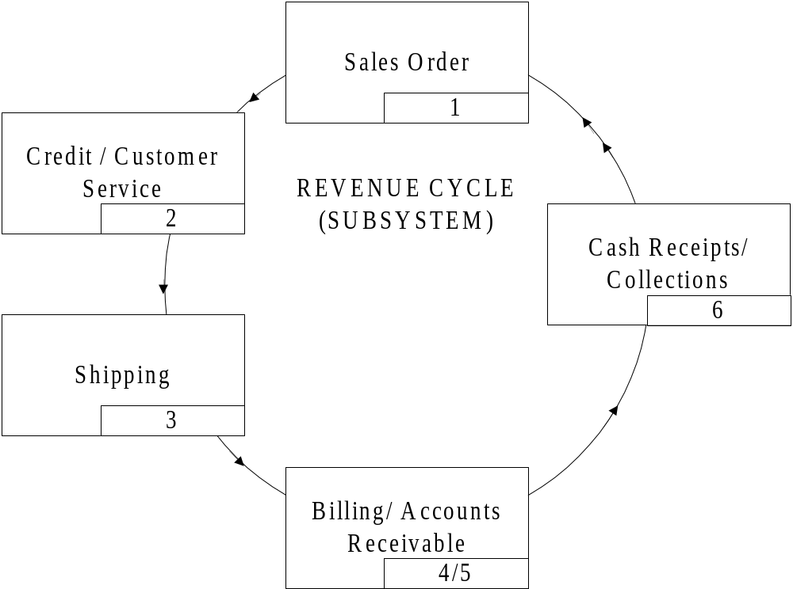


Slide 4
Revenue Cycle Databases
Master files
  customer master file
  accounts receivable master file
  merchandise inventory master file
Transaction and Open Document Files
  sales order transaction file
    open sales order transaction file
  sales invoice transaction file
  cash receipts transaction file
Other Files
  shipping and price data reference file
  credit reference file (may not be needed)
  salesperson file (may be a master file)
  Sales history file
  cash receipts history file
  accounts receivable reports file

Slide 5
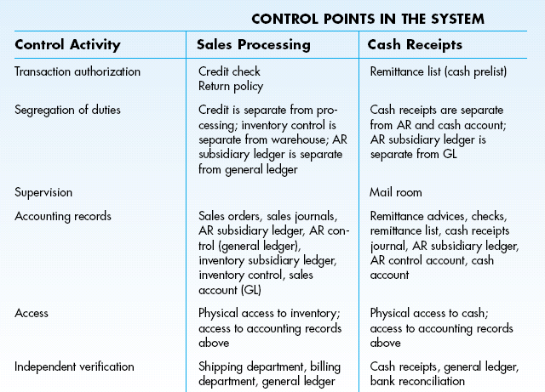
Summary of Internal Controls

Slide 6
Authorisation Controls
Proper authorisation of transactions (documentation) should occur so that only valid transactions get processed.
Within the revenue cycle, authorisation should take place when:
  a sale is made on credit (authorisation)
  a cash refund is requested (authorisation)
  posting a cash payment received to a customer’s account (cash pre-list)
Notes:
13

Slide 7
Segregation of Functions: Three Rules
Transaction authorisation should be separate from transaction processing.
Asset custody should be separate from asset record-keeping.
The organization should be so structured that the perpetration of a fraud requires collusion between two or more individuals.
Notes:
14

Slide 8
Segregation of Functions
Sales Order Processing
  credit authorisation separate from SO processing
  inventory control separate from warehouse
  accounts receivable sub-ledger separate from general ledger control account
Cash Receipts Processing
  cash receipts separate from accounting records
  accounts receivable sub-ledger separate from general ledger
Notes:
15

Slide 9
Supervision
Often used when unable to enact appropriate segregation of duties.
Supervision of employees serves as a deterrent to dishonest acts and is particularly important in the mailroom.
Notes:
16

Slide 10
Accounting Records
With a properly maintained audit trail, it is possible to track transactions through the systems and to find where and when errors were made:
  pre-numbered source documents
  special journals
  subsidiary ledgers
  general ledger
  files
Notes:
17

Slide 11
Access Controls
Access to assets and information (accounting records) should be limited.
Within the revenue cycle, the assets to protect are cash and inventories and access to records such as the accounts receivable subsidiary ledger and cash journal should be restricted.
Notes:
20

Slide 12
Independent Verification
Physical procedures as well as record-keeping should be independently reviewed at various points in the system to check for accuracy and completeness:
  shipping verifies the goods sent from the warehouse are correct in type and quantity
  warehouse reconciles the stock release document (picking slip) and packing slip
  billing reconciles the shipping notice with the sales invoice
  general ledger reconciles journal vouchers from billing, inventory control, cash receipts, and accounts receivable
Notes:
19

Slide 13
Automating the Revenue Cycle
Authorisations and data access can be performed through computer screens.
There is a decrease in the amount of paper.
The manual journals and ledgers are changed to disk or tape transaction and master files.
Input is still typically from a hard copy document and goes through one or more computerized processes.
Processes store data in electronic files (the tape or disk) or prepare data in the form of a hardcopy report.

Slide 14
Automating the Revenue Cycle …
Revenue cycle programs can include:
  formatted screens for collecting data
  edit checks on the data entered
  instructions for processing and storing the data
  security procedures (passwords or user IDs)
  steps for generating and displaying output
To understand files, you must consider the record design and layout.
The documents and the files used as input sources must contain the data necessary to generate the output reports.

Slide 15
Computer-Based Accounting Systems (CBAS)
CBAS technology can be viewed as a continuum with two extremes:
  automation - use technology to improve efficiency and effectiveness
  reengineering – use technology to restructure business processes and firm organization
Notes:
21

Slide 16
Reengineering Sales Order Processing Using Real-Time Technology
Manual procedures and physical documents are replaced by interactive computer terminals.
Real time input and output occurs, with some master files still being updated using batches.
  Real-time - entry of customer order, printout of stock release, packing slip and bill of lading; update of credit file, inventory file, and open sales orders file
  Batch - printout of invoice, update of closed sales order (journal), accounts receivable and general ledger control account
Notes:
27

Slide 17
Advantages of Real-Time Processing
Shortens the cash cycle of the firm by reducing the time between the order date and billing date
Better inventory management which can lead to a competitive advantage
Fewer clerical errors, reducing incorrect items being shipped and bill discrepancies
Reduces the amount of expensive paper documents and their storage costs
Notes:
28

Slide 18
Point-of-Sale Systems
Point of sale systems are used extensively in retail establishments.
  Customers pick the inventory from the shelves and take them to a cashier.
The clerk scans the universal product code (UPC). The POS system is connected to an inventory file, where the price and description are retrieved.
  The inventory levels are updated and reorder needs can immediately be detected.
Notes:
31

Slide 19
Point-of-Sale Systems …
The system computes the amount due. Payment is either cash, cheque, ATM or credit card in most cases.
  No accounts receivables
If ATM or credit cards are used, an on-line link to receive approval is necessary.
At the end of the day or a cashier’s shift, the money and receipts in the drawer are reconciled to the internal cash register tape or a printout from the computer’s database.
  Cash over and under must be recorded
Notes:
32

Slide 20
Reengineering Using EDI
EDI helps to expedite transactions.
The customer’s computer:
  determines that inventory is needed
  selects a supplier with whom the business has a formal business agreement
  dials the supplier’s computer and places the order
The exchange is completely automated.
  No human intervention or management
Notes:
35

Slide 21
EDI System
Company A
Company B
Application
Software
Purchases
System
Sales Order
System
Application
Software
EDI
Translation
Software
EDI
Translation
Software
Direct Connection
Communications
Software
Communications
Software
Other
Mailbox
Company
A’s mailbox
VAN
Company
B’s mailbox
Other
Mailbox
Notes:
14

Slide 22
Reengineering Using the Internet
Typically, no formal business agreements exist as they do in EDI.
Most orders are made with credit cards.
Mainly done with e-mail systems, and thus a turnaround time is necessary
  Intelligent agents are needed to eliminate this time lag.
Security and control over data is a concern with Internet transactions.
Notes:
36

Slide 23
CBAS Control Considerations
Authorisation - in real-time systems, authorisations are automated
  Programmed decision rules must be closely monitored.
Segregation of Functions - consolidation of tasks by the computer is common
  Protect the computer programs
  Coding, processing, and maintenance should be separated.
Supervision - in POS systems, the cash register’s internal tape or database is an added form of supervision
Access Control - magnetic records are vulnerable to both authorized and unauthorized exposure and should be protected
  Must have limited file accessibility
  Must safeguard and monitor computer programs
Notes:
37

Slide 24
CBAS Control Considerations …
Accounting Records - rest on reliability and security of stored digitalized data
  Accountants should be skeptical about the accuracy of hard-copy printouts.
  Backups - the system needs to ensure that backups of all files are continuously kept
Independent Verification – consolidating accounting tasks under one computer program can remove traditional independent verification controls. To counter this problem:
  perform batch control balancing after each run
  produce management reports and summaries for end users to review
Notes:
39

Slide 25
PC-Based Accounting Systems …
Used by small firms and some large decentralized firms
Allow one or few individuals to perform entire accounting function
Most systems are divided into modules controlled by a menu-driven program:
  general ledger
  inventory control
  payroll
  cash disbursements
  purchases and accounts payable
  cash receipts
  sales order
Notes:
40

Slide 26
PC Control Issues
Segregation of Duties - tend to be inadequate and should be compensated for with increased supervision, detailed management reports, and frequent independent verification
Access Control - access controls to the data stored on the computer tends to be weak; methods such as encryption and disk locking devices should be used
Accounting Records - computer disk failures cause data losses; external backup methods need to be implemented to allow data recovery
Notes:
41

